Slide 1
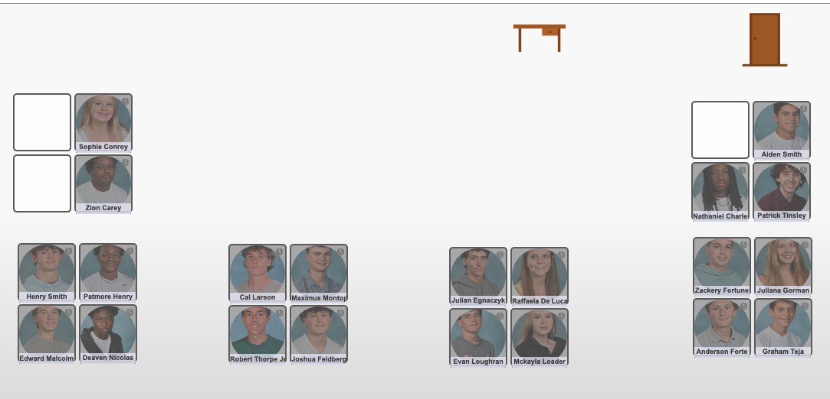
Please find your seat

Slide 2
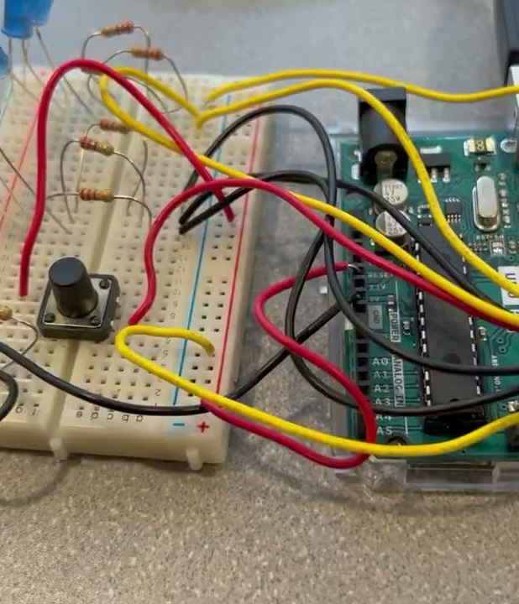
Themes in
Engineering
Welcome
Mr. Salemi · Natick High School

Slide 3
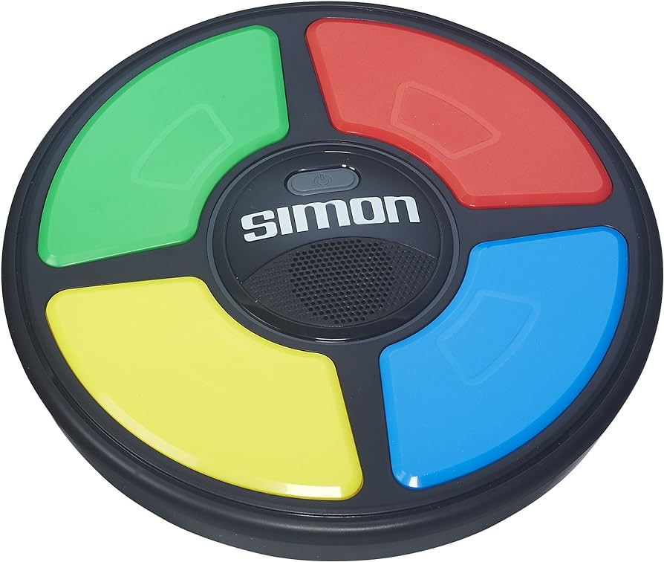
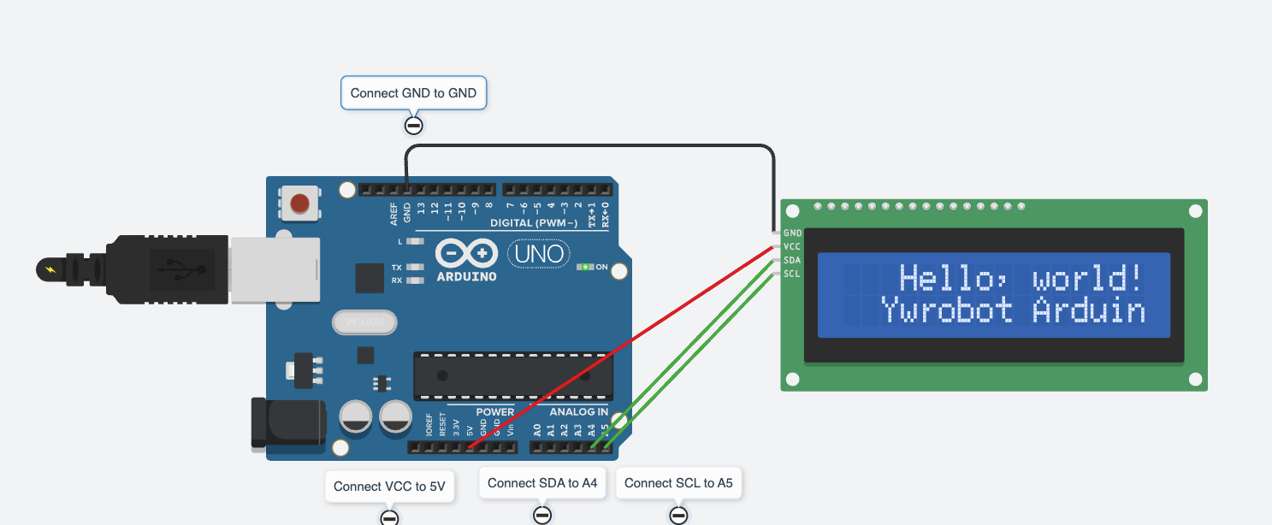
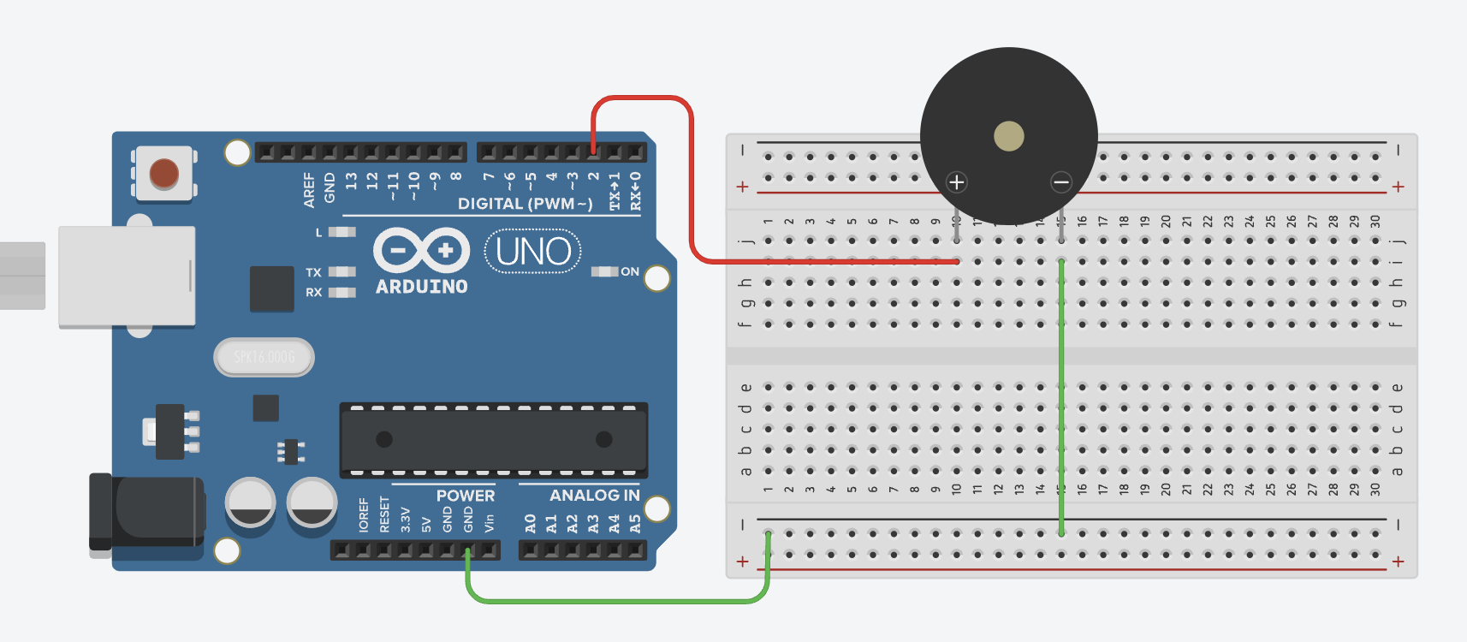
By December, you will have built this.
The Simon game
A screen that says hello
A synthesizer
Not a model of one. A working one, on your bench, running code you wrote.

Slide 4
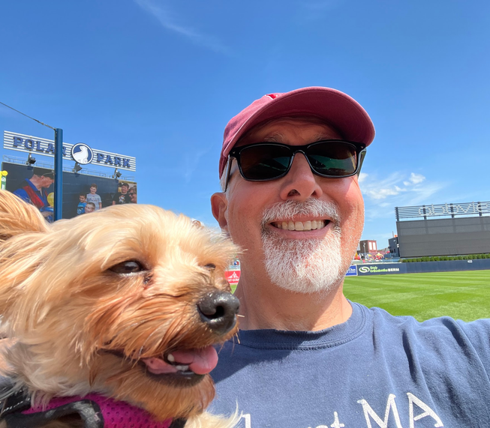
Mr. Salemi (and Mae)
Engineer, 1985–2022
37 years designing hardware and software
UMass Amherst — Computer Engineering
Babson College — MBA
Published author
The Tucker Mysteries, and books on engineering

Slide 5
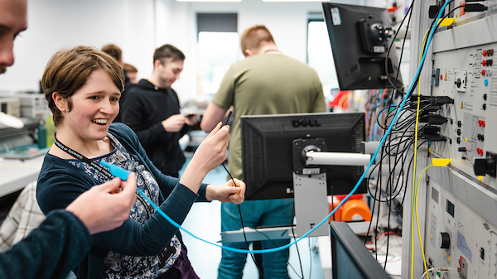
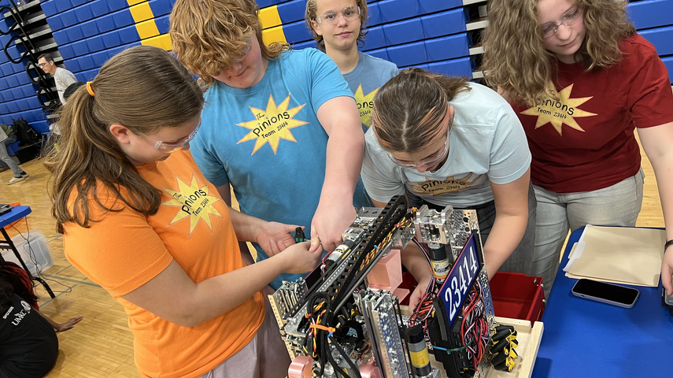
Two facts
Engineering is fun.
Engineering is not easy.
Both are true at the same time. That is the whole class.

Slide 6
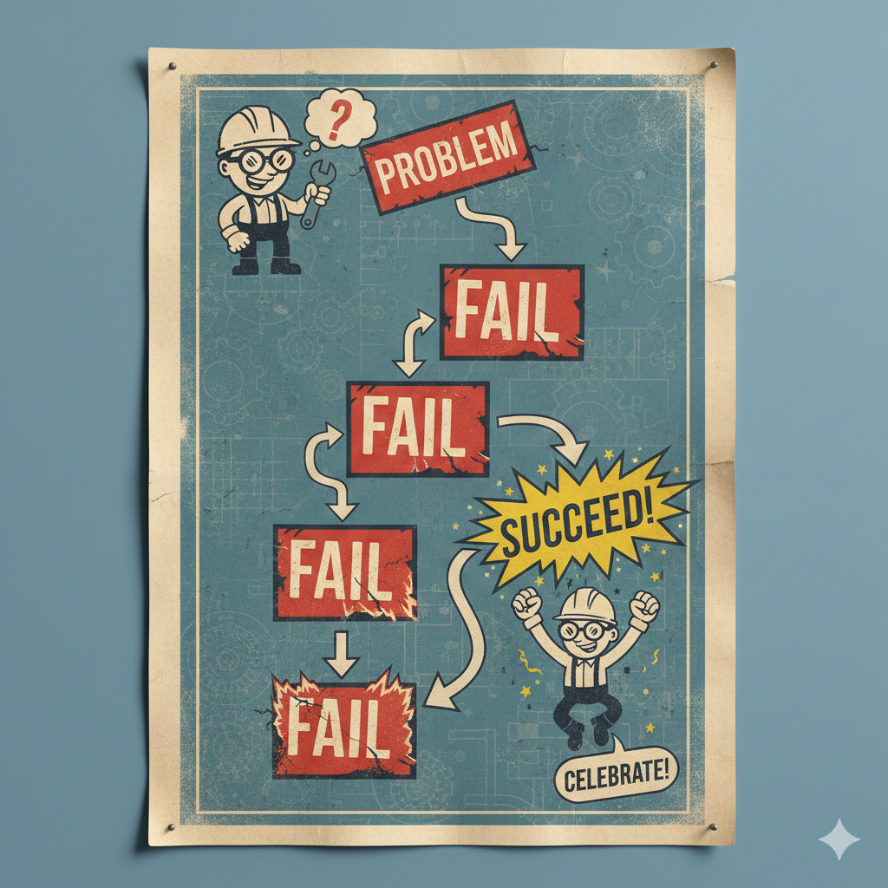
This is not how most classes work.
What you are used to
Get a problem you already know how to solve.
Solve it.
Success.
What this is
Try it. It does not work.
Find out why. Fix it. It still does not work.
Fix it again. Now it works — and you know why.

Slide 7
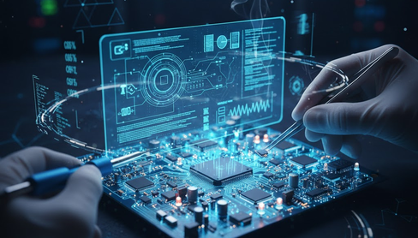
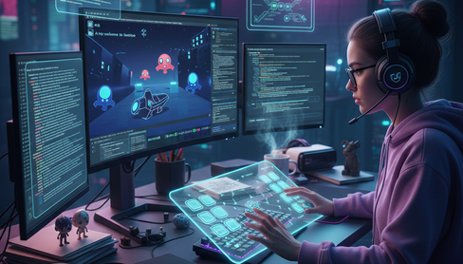
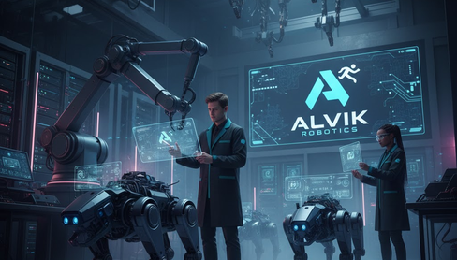
Three projects. Three kinds of engineering.
01
02
03
Electronics
Software
Robotics
Simulate it. Build it. Make it blink, buzz, and play.
Write the spec. Make an AI build it. Test what it gives you.
Make something move on purpose.

Slide 8
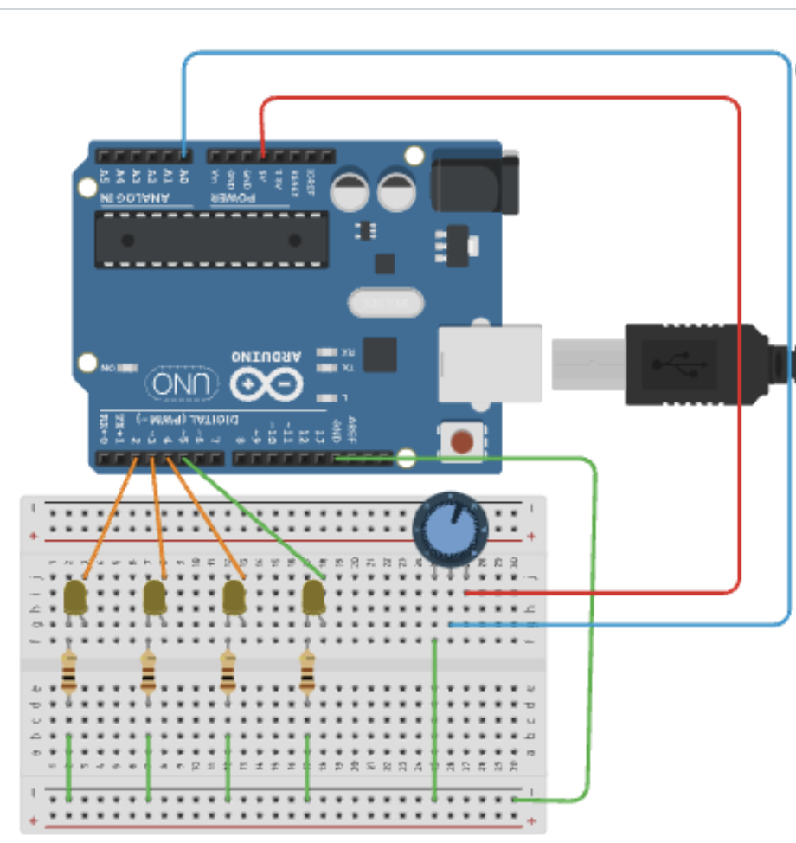
This class is for you if…
1
You are curious whether engineering is a career you want.
2
You like the moment something finally works.
3
You are willing to be stuck for twenty minutes and keep going.

Slide 9
And it is not for everyone.
Your phone is in the holder every period.
You will be stuck, and being stuck is the job — not a sign you are failing.
A project is graded on whether it works.
If that is not the class you were hoping for, there is still time to switch.
No hard feelings. I would rather you find the right room than spend a term in the wrong one.

Slide 10

Meet an engineer
Someone who does this for a living.
Watch, then tell me one thing about the job that surprised you.

Slide 11
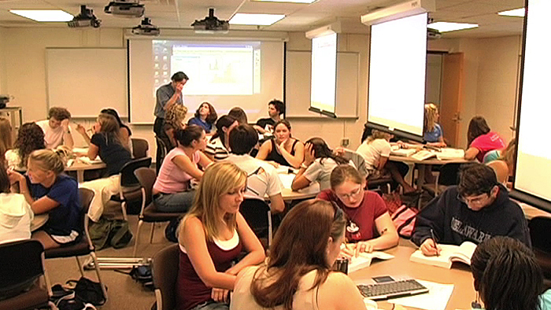
The Big Rule
Maintain a productive
learning environment.

Slide 12
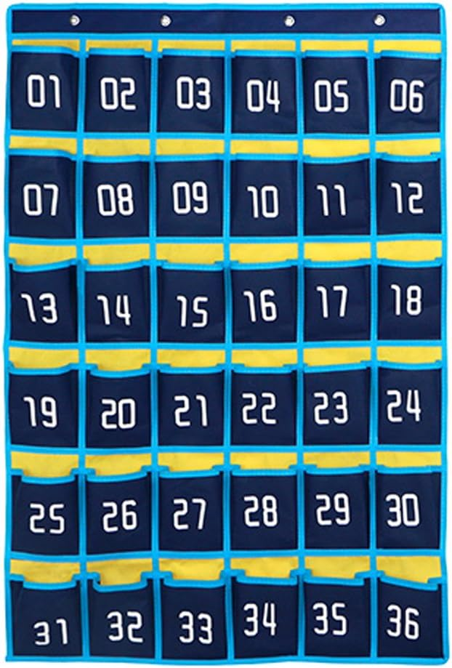
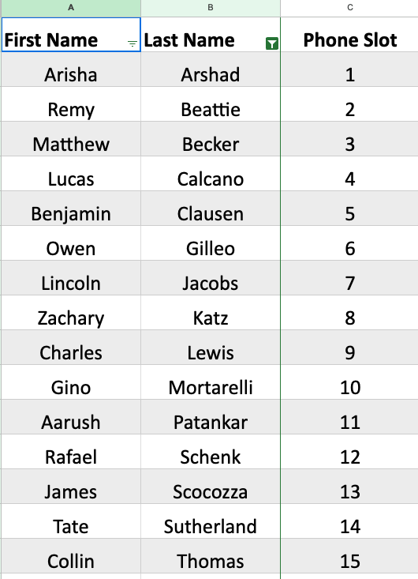
Your phone goes in the holder. Every class.
First time
I remind you.
Second time
I notify Mr. Hinnenkamp, the department head.
After that
I write you up, without warning.
Find your number on the alphabetical list.
Your hands are going to be busy. That is the real reason.

Slide 13
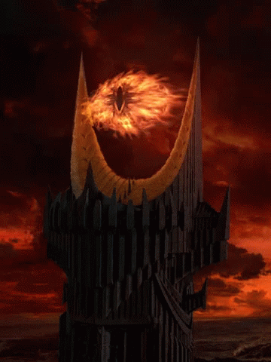
No phones.
The eye is always watching.

Slide 14
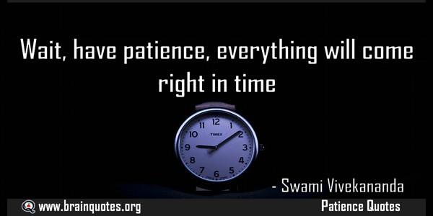
Stay to the end.
During relaxation time, stay at your table and relax.
No hanging by the door.

Slide 15
Grading
20
18
0
On time, and it works.
Late — or a redo that comes back right.
Only if you never finish it.
A lab that is not working yet comes back to you as a redo, as many times as it takes, and is worth 18 once it is right. Show both halves — the simulation and the real circuit — to get it checked off.

Slide 16
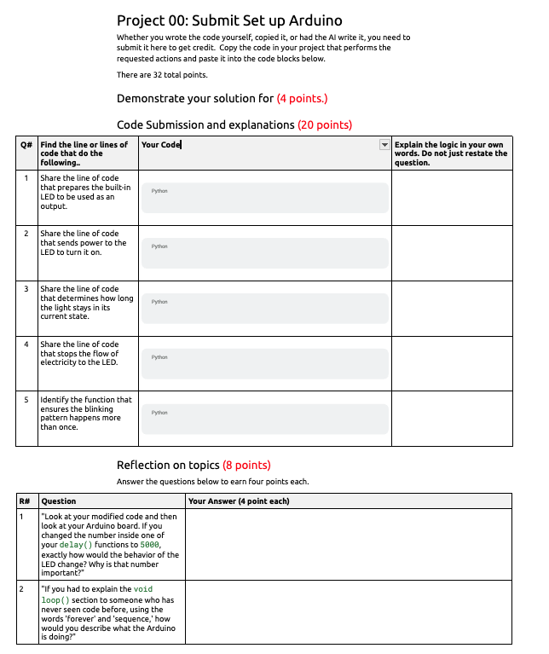
Every project has a submission document.
Answer the questions in it.
Submit the document to get credit. A project that is built but not submitted is not finished.

Slide 17
Join the Google Classroom
3kicjrxy

Slide 18
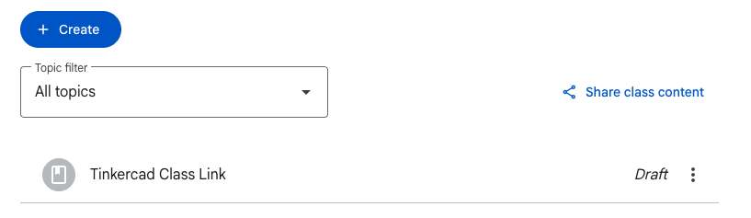
Tinkercad
Set up your account.

Slide 19
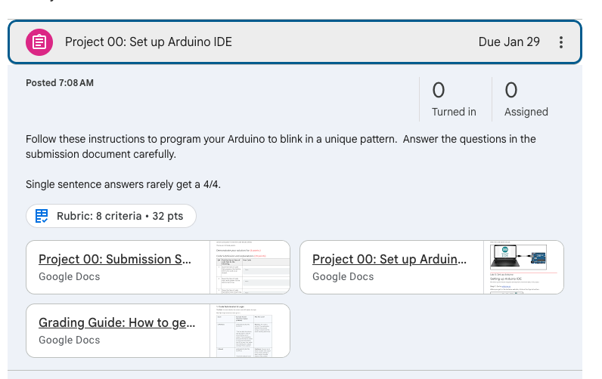
Project 00: Set up your Arduino IDE
Make the Arduino blink.

Slide 20
Engineering is fun.
Engineering is not easy.
Hands on keyboards.

